Slide 1

What
By Milton P. Jr. ☺ educationnow@yahoo.com.br

Slide 2
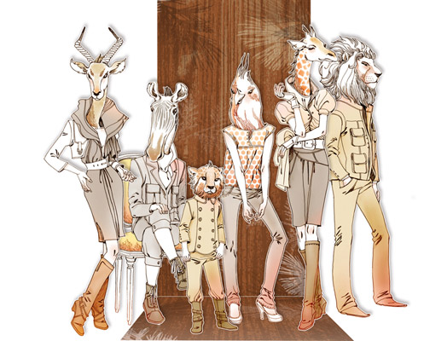

If you could be an animal, what animal would you be?

Slide 3
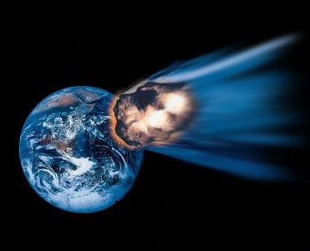
If you only had 24 hours to live, what would you do?
By Milton P. Jr. ☺ educationnow@yahoo.com.br

Slide 4
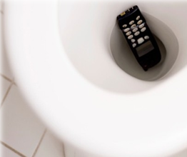
What if your smart-phone fell into the toilet, what would you do?

Slide 5
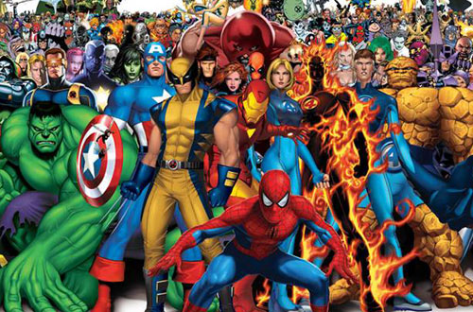
If you could be a super hero, which super hero would you be?

Slide 6
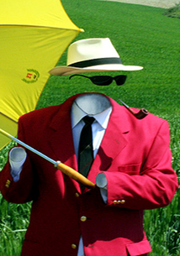
If you were invisible for a day what would you do and why?
By Milton P. Jr. ☺ educationnow@yahoo.com.br

Slide 7
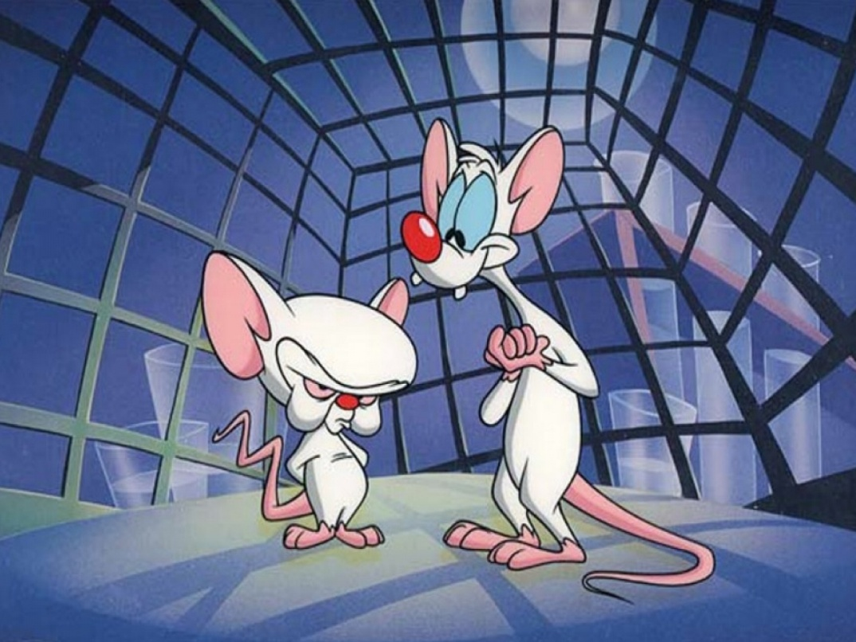
If you had to commit a crime, what would you do?

Slide 8
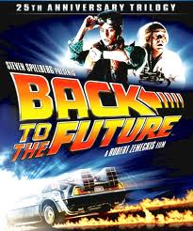
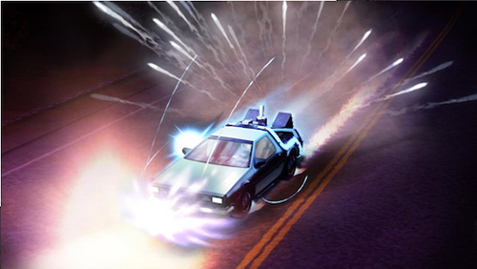
If there was a time machine and you could travel back in time, where and when would you go and why?

Slide 9
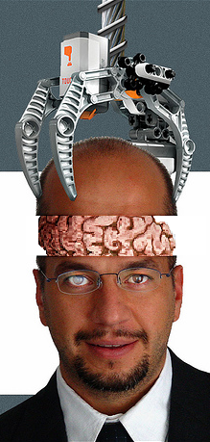
If you could be another man or woman for a day, who would you choose?
By Milton P. Jr. ☺ educationnow@yahoo.com.br

Slide 10
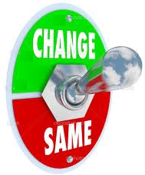
If you could change one thing about your country, what would it be?
By Milton P. Jr. ☺ educationnow@yahoo.com.br

Slide 11
Think about one topic and ask a partner a question like this:
What WOULD you do if…
By Milton P. Jr. ☺ educationnow@yahoo.com.br

Slide 12
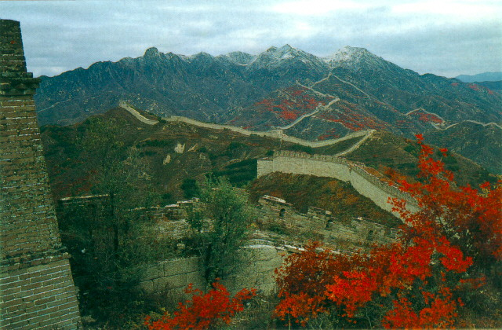
Conditional II (present/future – impossible)
When something is NOT possible now, or in the future.
Form:
If (past), would +Vbase.
Example:
If he spoke Chinese, he would work as a guide in China. (BUT: He doesn’t speak Chinese, so it’s impossible.)

Slide 13
Let’s analyze the form
If + simple past tense, S + would / could / might + verb
IF CLAUSE MAIN CLAUSE
OR
S + would / could / might + verb if + simple past tense
MAIN CLAUSE IF CLAUSE
* If + simple past tense, S + would / could / might + be verb-ing (for continuous situations)
* If the verb in if clause is “be”, we use “were” for all subjects in academic English. “Was” is used in spoken English.
Eg. If it were the weekend, I would still be sleeping.

Slide 14
If Clauses (unreal present)
Unreal situations
Example:
If I knew the address, I would tell you.

Slide 15
Remember:
The four words that NEVER (well, almost never) appear in the IF clause are:
will, won’t, would, wouldn’t
Example:
If we will see it, we will be angry.

Slide 16
Some examples for different forms
Positive sentences
Your boss would be happy if you were trying to sell more advanced and expensive models.
You would suggest a more advanced model if your customers really needed it.
Negative sentences
I wouldn’t make the decision for them (if I were you).
I might not get so bored if I didn’t live in a small town.
Wh- questions
Where would you live if you could live anywhere in the world?
What would you do in my situation?
Yes/No questions
Would you want to be a girl or a boy if you had the chance to choose?
If you found a lot of money on the street, would you keep it or take it to the police station?

Slide 17
Practice time
Fill in the blanks with the correct form of the verb.
1. Where _____ (you/travel) to if you _____ (can) go anywhere?
Where would you travel if you could go anywhere?
2. What _____ (you/do) if you _____ (be) in my situation?
What would you do if you were in my situation?
3. If she _____ (know), she _____ (tell) you.
If she knew, she would tell you.
4. I _____ (have) a better job if I _____ (speak) English better.
I would have a better job if I spoke English better.
5. I _____ (never/forgive) you if I _____ (not be) your friend.
I would never forgive you if I weren’t your friend.

Slide 18
Paraphrase the following sentences by using if type 2.
1. She doesn’t like her job, so she doesn’t fulfill her responsibilities.
If she liked her job, she would fulfill her responsibilities.
2. I won’t go out tonight because I have an exam tomorrow.
I would go out tonight if I didn’t have an exam tomorrow.
3. Sally can’t swim, so she will not come to the pool with us.
If Sally could swim, she would come to the pool with us.

Slide 19
Complete the sentences using if type 1 or 2.
Terry: Hey, Ray. If you (1) _____ (have) time, can you go and pick up Bridget at the station? If she takes the 4 o'clock train, as she said, she (2) _____ (arrive) at 5.15.
Ray: I (3) _____ (pick) her up if I could, but I have a meeting at 4.30.
Terry: Can't you postpone it? You are the boss after all.
Ray: Yes, but I'm meeting some important clients, and it wouldn't look serious if a few hours before the meeting I (4) _____ (tell) them that I have to put it off. And the meeting is important. I'll make quite a lot of money if everything (5) _____ (go) well. Why don't you pick her up?
Terry: I would pick her up if my car (6) _____ (not be) at the garage. It's been there for days, and unless there's a miracle, they (7) _____ (not repair) it today. Something is broken and they won't be able to fix it until they (8) _____ (find) the spare part they need.
Ray: That's unlucky. Well, do you think Bridget (9) _____ (get) angry if nobody goes to the station to pick her up?
Terry: Well, if it were me, I (10) _____ (not get) angry.

Slide 20
Terry: Hey, Ray. If you (1) have time, can you go and pick up Bridget at the station? If she takes the 4 o'clock train, as she said, she (2) will arrive at 5.15.
Ray: I (3) would pick her up if I could, but I have a meeting at 4.30.
Terry: Can't you postpone it? You are the boss after all.
Ray: Yes, but I'm meeting some important clients, and it wouldn't look serious if a few hours before the meeting I (4) told them that I have to put it off. And the meeting is important. I'll make quite a lot of money if everything (5) goes well. Why don't you pick her up?
Terry: I would pick her up if my car (6) weren’t at the garage. It's been there for days, and unless there's a miracle, they (7) won’t repair it today. Something is broken and they won't be able to fix it until they (8) find the spare part they need.
Ray: That's unlucky. Well, do you think Bridget (9) will get angry if nobody goes to the station to pick her up?
Terry: Well, if it were me, I (10) wouldn’t get angry.

Slide 21
Complete the sentences to make them true for you.
If I were the prime minister, ______________________________.
If I the boss doesn’t like my project, ______________________________.
I will forgive you if ______________________________.
______________________________ if you weren’t my best friend.
If I don’t receive your e-mail, ______________________________.
If I were a millionaire, ______________________________.

Slide 22
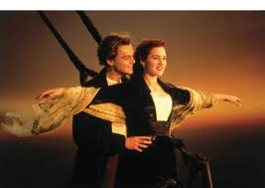
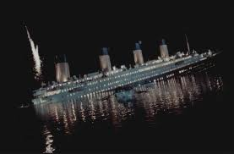

Slide 23
Titanic is a 1997 romantic disaster film directed by James Cameron. The movie tells the story of Jack Dawson, a poor artist, and Rose DeWitt Bukater, a young woman from a wealthy family, who meet and fall in love aboard the luxury ship RMS Titanic during its first voyage in 1912. Their romance develops as the ship travels across the Atlantic, but their story becomes tragic when the Titanic hits an iceberg and begins to sink. The film combines a fictional love story with the real historical disaster and became one of the most successful and well-known films in cinema history.

Slide 24
Past unreal 3rd conditionals
If the characters hadn’t been fictional, it would have won more than eleven academy awards.
Were the characters fictional?
Did it win more than eleven awards?

Slide 25
Past unreal 3rd conditionals
If Leonardo DiCaprio hadn’t played in the movie, it mightn’t have been so famous.
Did Leonardo Dicaprio play in the movie?
Was the movie famous?

Slide 26
Past unreal 3rd conditionals
If it hadn’t been directed by James Cameron, the movie couldn’t have reached success.
Was the movie directed by James Cameron?
Did the movie reach success?

Slide 27
We use 3rd conditionals to talk about ;
Past actions
Unreal situations
Their results

Slide 28
If the characters hadn’t been fictional, it would have won more than eleven academy awards.
→ certanity
If Leonardo DiCaprio hadn’t played in the movie, it mightn’t have been so famous.
→ possibility
If it hadn’t been directed by James Cameron, the movie couldn’t have reached success.
→ Ability

Slide 29
Past unreal 3rd conditionals
If I had known that the movie was very good, I would have watched it at the movie theatre.
(Reality : I didn’t know that the movie was very good, so I didn’t watch it at the movie theather)

Slide 30
How would you have felt if you had been on Titanic?

Slide 31
Form-Past unreal 3rd conditionals
If clause
Result clause
Result clause
If clause
If Jack had been rich,
If + S + past perfect (V3)
he would have got first-class ticket.
S + would/could/might + have + V3
OR
Jack would have got first-class ticket
S + would/could/might + have + V3
if he had been rich.
If + S + past perfect (V3)

Slide 32
Negative Form
If clause
Result clause
Result clause
If clause
If Rose hadn’t been beautiful,
(had not = hadn’t)
Jack wouldn’t have loved her.
(would not = wouldn’t, might not = mightn’t, could not = couldn’t)
OR
Jack wouldn’t have loved Rose
(would not = wouldn’t, might not = mightn’t, could not = couldn’t)
if she hadn’t been beautiful.
(had not = hadn’t)

Slide 33
What would you have done?
A man was walking down the street when he found $100 bills lying on the ground. There was no one else around. He picked them up and put them in his pocket.
A woman came home late and found her apartment door unlocked. She was sure she had locked it. No one else had the keys. She went inside.

Slide 34
If you hadn’t been born, what would have been different?

Slide 35
MIXED CONDITIONALS

Slide 36
Mixed Conditionals
Function: When the time in the ‘if clause’ if different from the time in the ‘result clause’
Form 1:
If + had + V3, would + Vbase (types 3 and 2)
Would + Vbase + if + had +V3
Example:
If I had passed the COPE, I wouldn’t be at BUSEL.
past situation present result
Form 2:
If + V2, would have + V3 (types 2 and 3)
Would have + V3 + if + V2
Example:
If I was/were more sensible, I would have saved more money.
present situation past result

Slide 37
she didn't sign up for the ski trip last week
and she does not join us today.
If she had signed up for the ski trip last week, she would join us today.

Slide 38
darren wasted his christmas bonus gambling in Las Vegas and he is not coming to mexico with us next month.
If Darren hadn't wasted his Christmas bonus gambling in Las Vegas, he would go to Mexico with us next month.

Slide 39
I am not currently rich and that is why I didn't buy the Ferrari yesterday.
If I were rich, I would have bought that Ferrari we saw yesterday

Slide 40
I have to work a lot and that is why I didn't go to the party last night.
If I didn't have to work so much, I would have gone to the party last night

Slide 41
LET’S PRACTICE
a. Tom is not going to come to dinner tomorrow because you insulted him yesterday.
b. But, he …………….(come) if you ………………. (insult) him.

Slide 42
a. Marie is unhappy because she gave up her career when she got married.
b. But, Marie ……………(be) happy if she …………….. (give, not) up her career when she got married.

Slide 43
a. Dr. Mercer decided not to accept the research grant at Harvard because he is going to take six months off to spend more time with his family.
b. But, Dr. Mercer ……………(accept) the research grant at Harvard if he ……….(take, not) six months off to spend more time with his family.

Slide 44
a. Professor Schmitz talked so much about the Maasai tribe because she is an expert on African tribal groups.
b. But, Professor Schmitz …………..(talk, not) so much about the Maasai tribe if she ……………..(be, not) an expert on African tribal groups.

Slide 45
a. I am unemployed because I had a disagreement with my boss and I was fired.
b. But, I ………………(be, not) unemployed if I ………………….(have, not) a disagreement with my boss and I (be, not) fired.

Slide 46
a. The hotels filled up months in advance because the festival is going to include jazz artists from around the globe.
b. But, the hotels …………(fill) up months in advance if the festival …………(include) jazz artists from around the globe.

Slide 47
Now, let’s focus on in case.
We have saved some money in case we don’t find a cheap place in a short time.
Why have they saved money?
Will they or won’t they find a cheap place in a short time?
Take my Spanish friend’s phone number in case you need help with anything.
Why are they taking the phone number?
Will they or won’t they need help with anything?
We use present simple tense with in case, but it refers to future time!

Slide 48
If vs. In case
IF | IN CASE
used to express the condition of a clause introduces condition used to represent the actions happening due to the condition. we should do an action AFTER something happens | used to talk about things we do in order to be prepared for possible future situations introduces possibility used to represent precautions we take for future situations we should do an action BEFORE something happens (or doesn’t happen)

Slide 49
Complete the blanks with if or in case.
Tom may come today. I will stay home all day _______ he comes.
Tom may come today. I will stay home all day __in case__ he comes.
You must call the police _______ your car is stolen.
You must call the police __if__ your car is stolen.
You can stay with us _______ you come to İstanbul.
You can stay with us __if__ you come to İstanbul.
Take some more money _______ you need during your travel.
Take some more money __in case__ you need during your travel.
We should insure our car _______ we have an accident.
We should insure our car __in case__ we have an accident.

